Slide 1
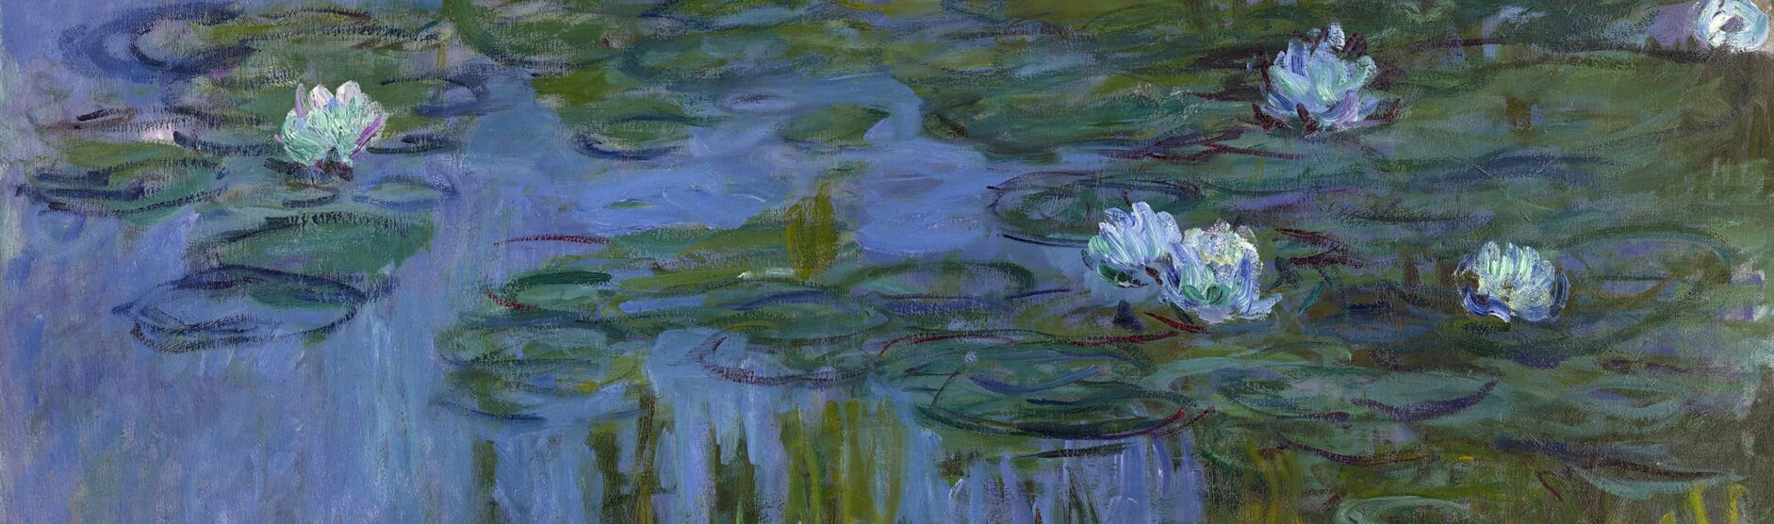
Designing tools that act as creative collaborators
Luiza, Claire, Mikela, Elijah
Assignment 1

Slide 2
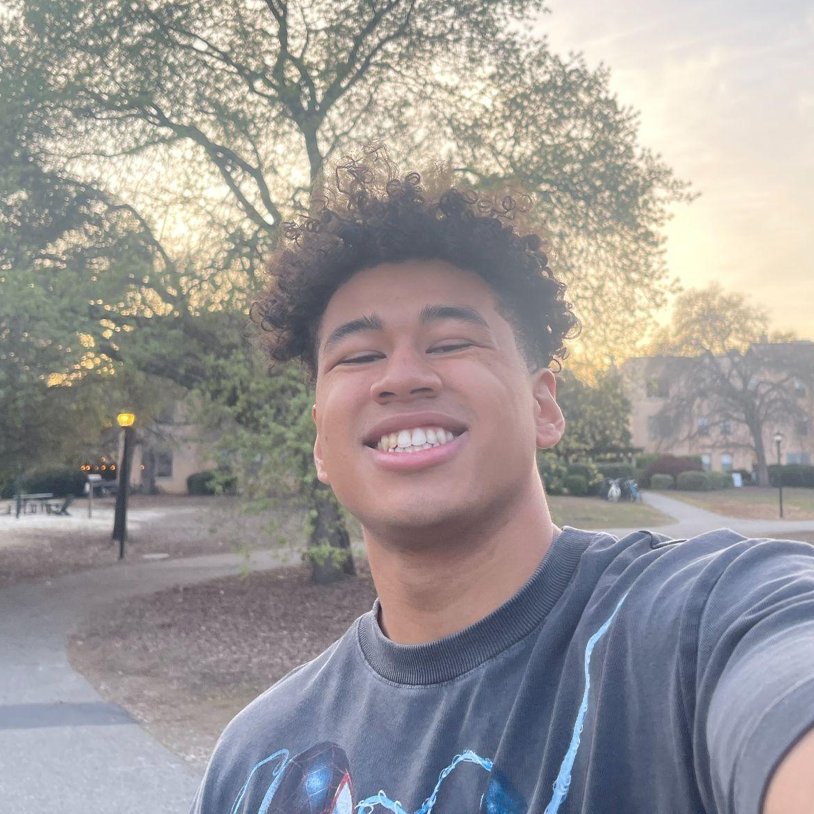

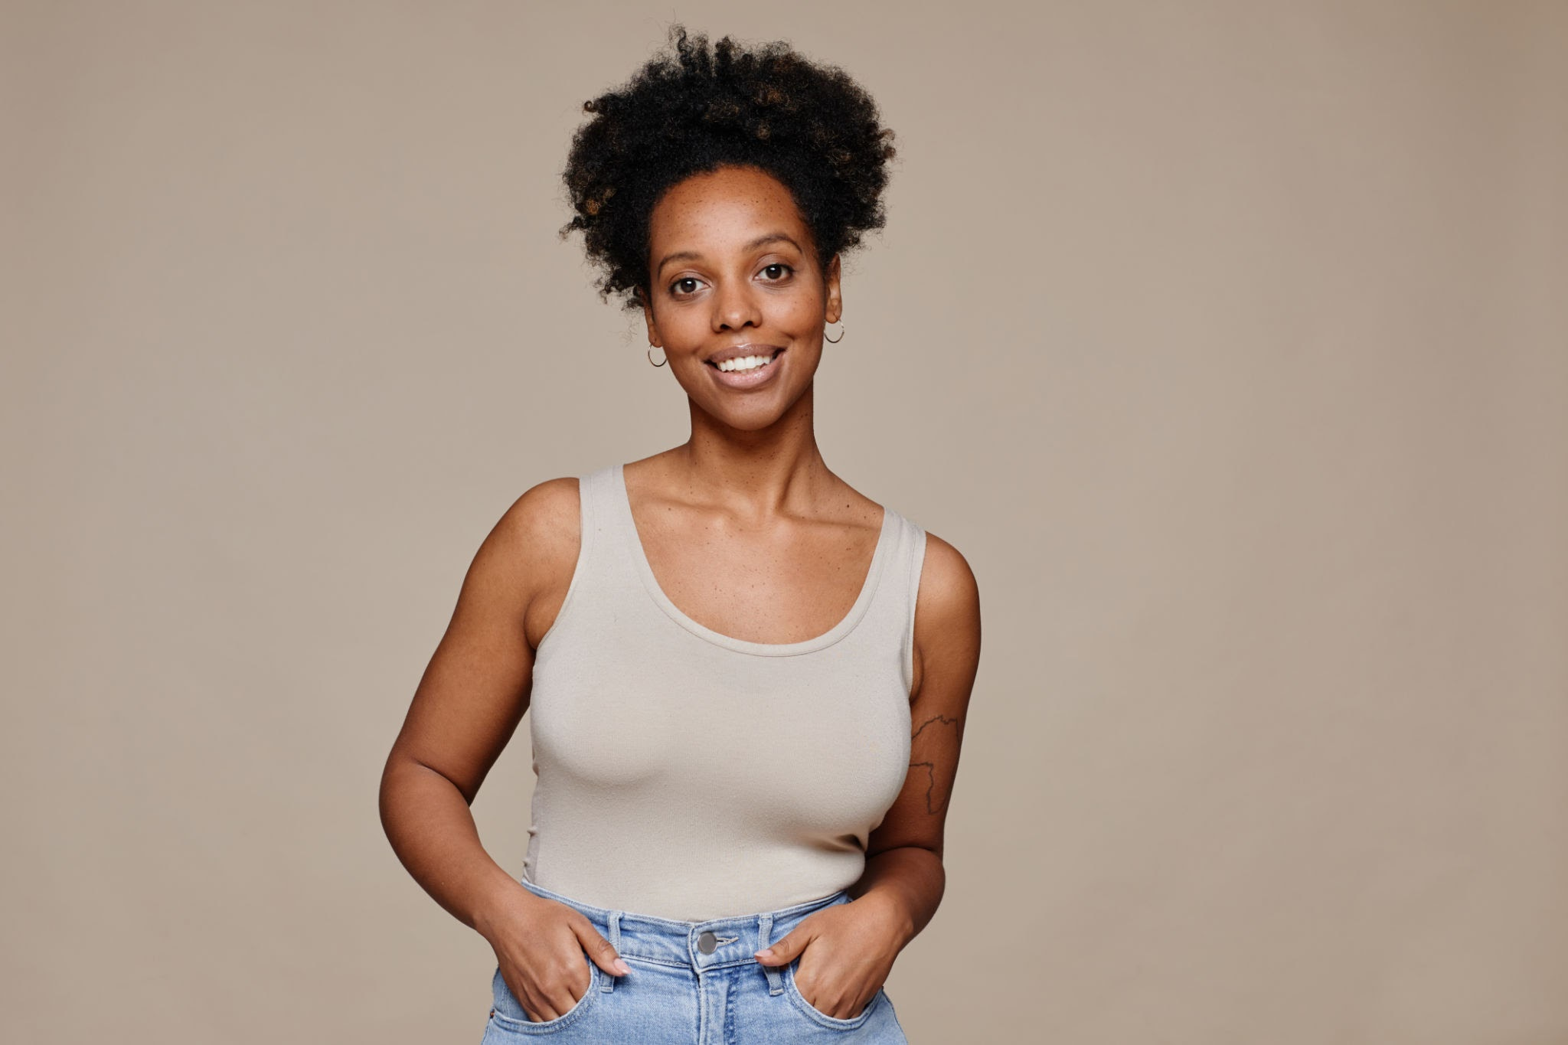
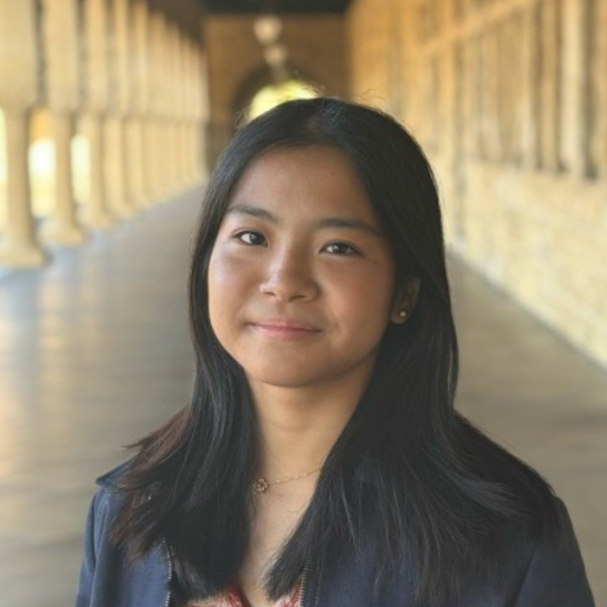
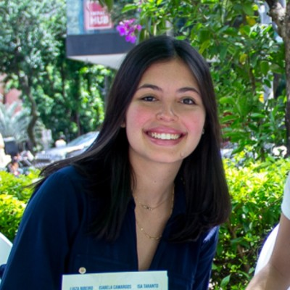
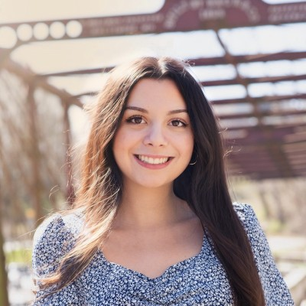
Meet the team
Elijah, Luiza, Claire, Mikela
Assignment 1
Elijah
Luiza
Claire
Mikela
Symbolic Systems '26
Design + Computer Science
‘28
Computer Science ‘27
Symbolic Systems ‘27

Slide 3
Domain selection
Elijah, Luiza, Claire, Mikela
Assignment 1
Aversion to AI generated art
Gaining granular control over creative processes
Interest in various mediums
Notes:
We first discussed what interested us about this theme and what types of users we would be interested in learning more about. We realized that, because art is so broad, we wanted to explore the perspective of several different mediums. Because of this, we decided to focus on the process of creating and planning art.

Slide 4
Domain selection
Elijah, Luiza, Claire, Mikela
Assignment 1
How artists plan their creative projects
Aversion to AI generated art
Gaining granular control over creative processes
Interest in various mediums
Notes:
We first discussed what interested us about this theme and what types of users we would be interested in learning more about. We realized that, because art is so broad, we wanted to explore the perspective of several different mediums. Because of this, we decided to focus on the process of creating and planning art.

Slide 5
Finding participants
Elijah, Luiza, Claire, Mikela
Assignment 1
1
2
3
4
Experience
Context
Demographics
Art Medium
Years of experience
Profession
Freelance vs. Industry
How’d we meet
Where’d we meet
Compensation
Age
Gender
Race
Analog vs Digital
Multimedia?
Notes:
Why were they chosen? Why are they appropriate? How were they recruited/compensated?

Slide 6
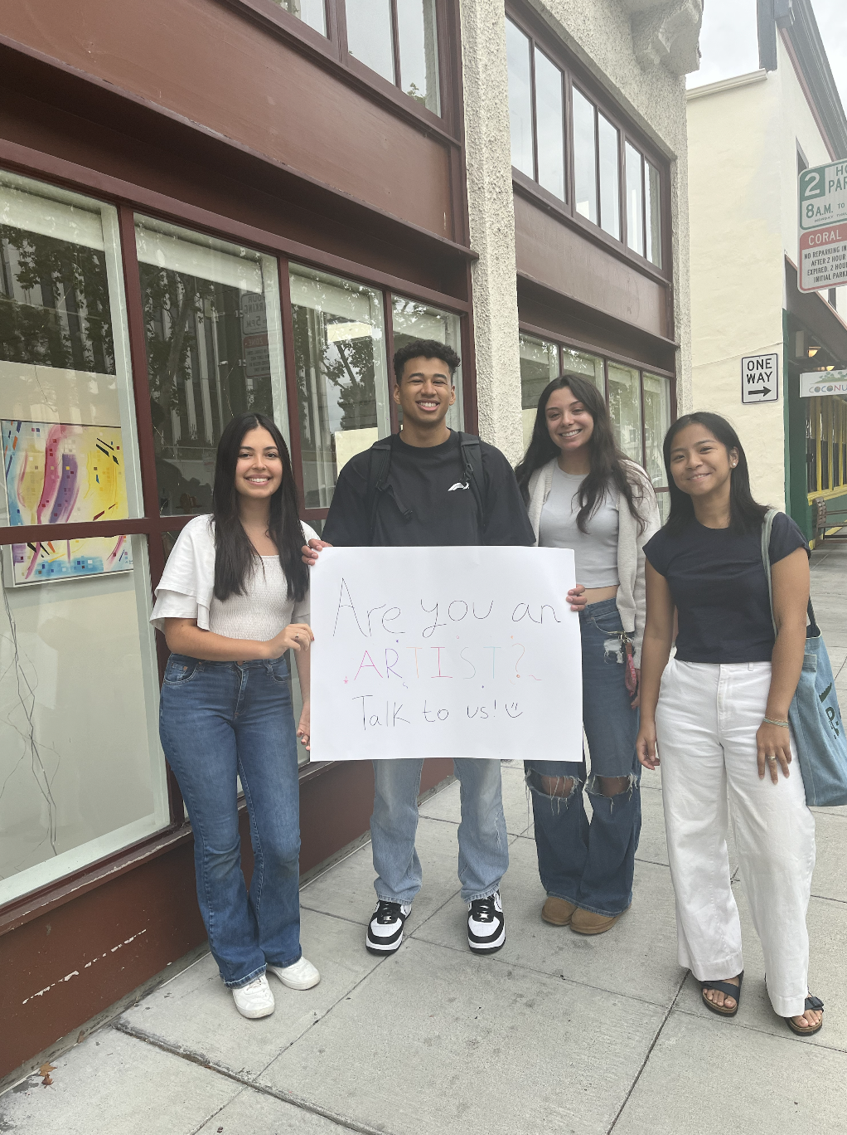
Finding participants
Elijah, Luiza, Claire, Mikela
Assignment 1
Random sampling in downtown Palo Alto
Mutual connections
Art focused spaces (galleries/studios)

Slide 7
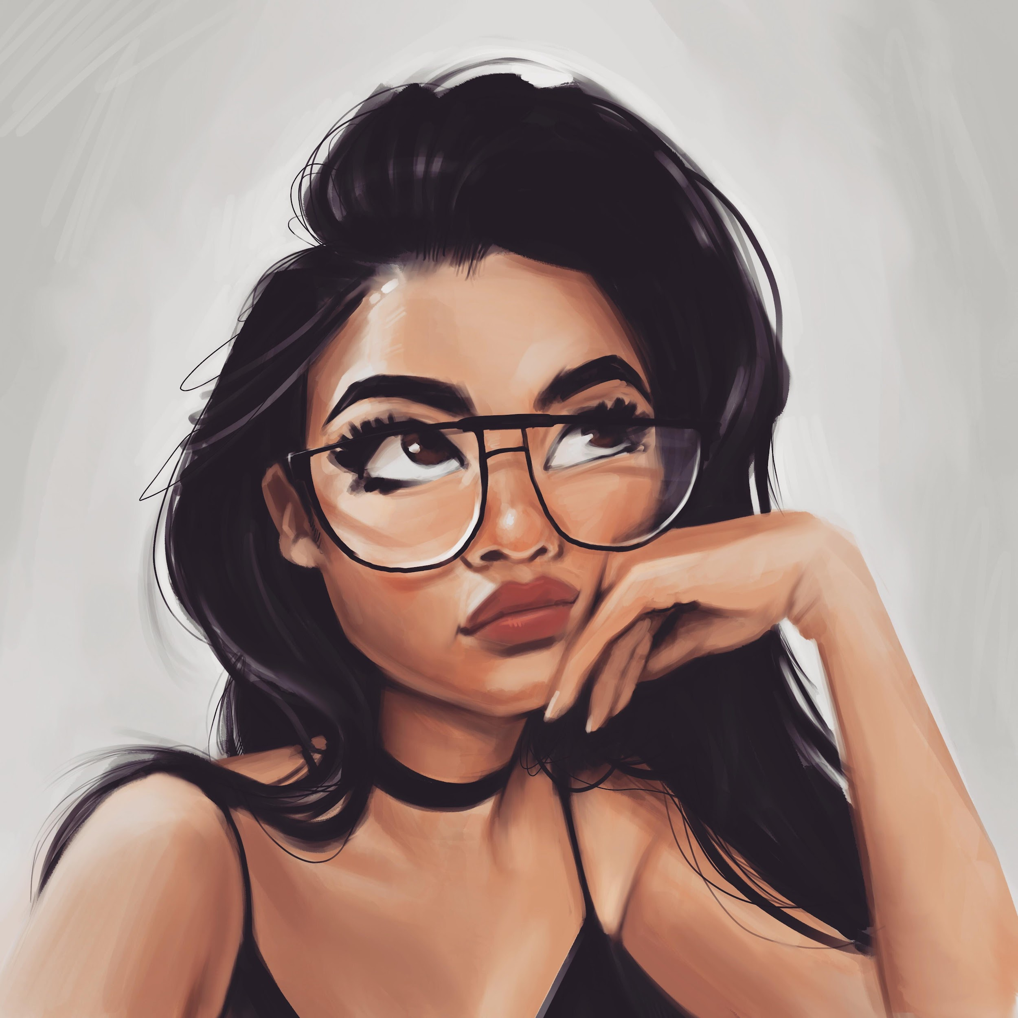
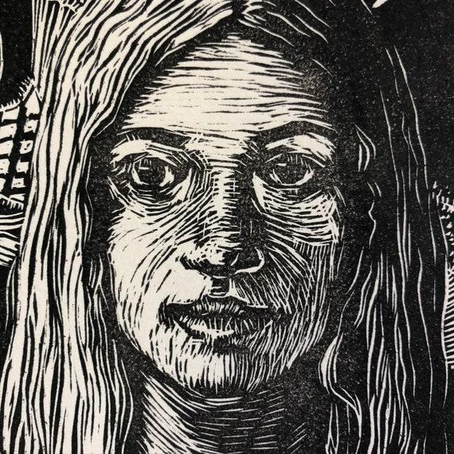
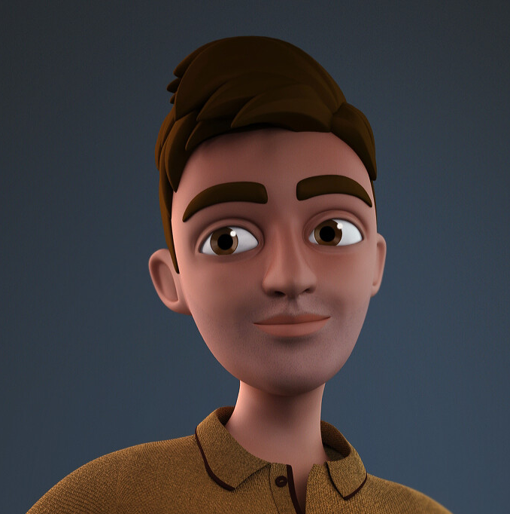

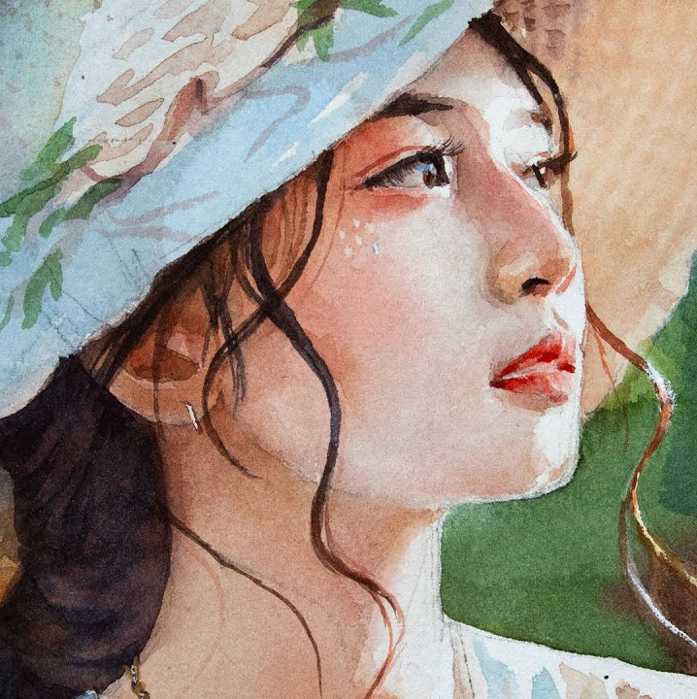
Participants
Elijah, Luiza, Claire, Mikela
Assignment 1
Vanessa
Stephanie
Product Design @ Adobe AI
Digital Art Hobbyist
Senior UX Designer @ Oracle
Analog Art Hobbyist (Print + Painting)
Keith
Willow
Chloe
25+ Years in Digital Art industry (VR/Animation/Film)
Film Student
20+ years of art hobbies

Slide 8
Extreme user
Elijah, Luiza, Claire, Mikela
Assignment 1
Keith
25+ Years in Digital Art industry (VR/Animation/Film)
Mediums used
Years practicing

Slide 9
Guiding questions
Elijah, Luiza, Claire, Mikela
Assignment 1
“What inspires
your art?”
“Do you use AI to help in any step of the process?”
“How do you plan your creative work?”
“How do you organize your art and ideas?”
“How has your process in making art changed over time?”
Notes:
claire

Slide 10
Interview Results
Elijah, Luiza, Claire, Mikela
Assignment 1

Slide 11
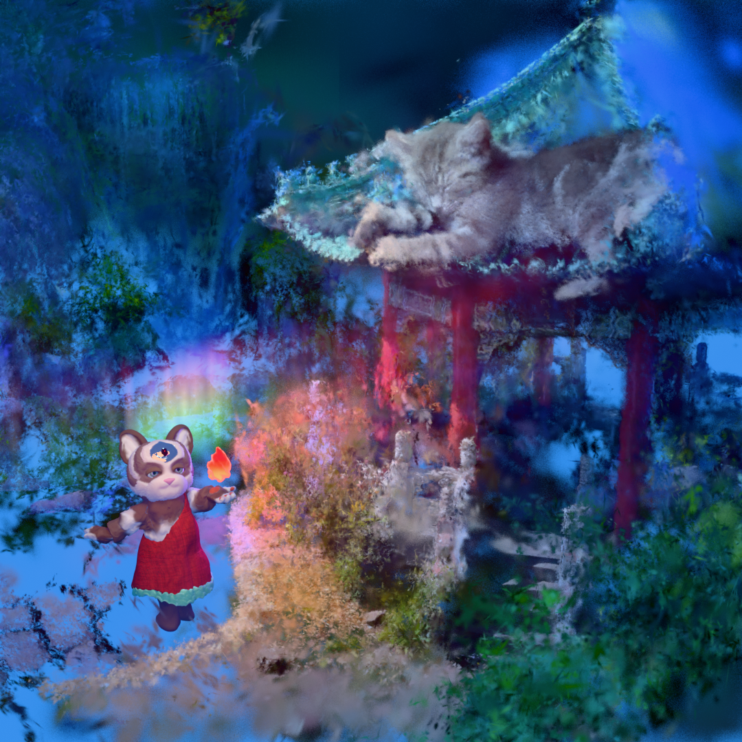
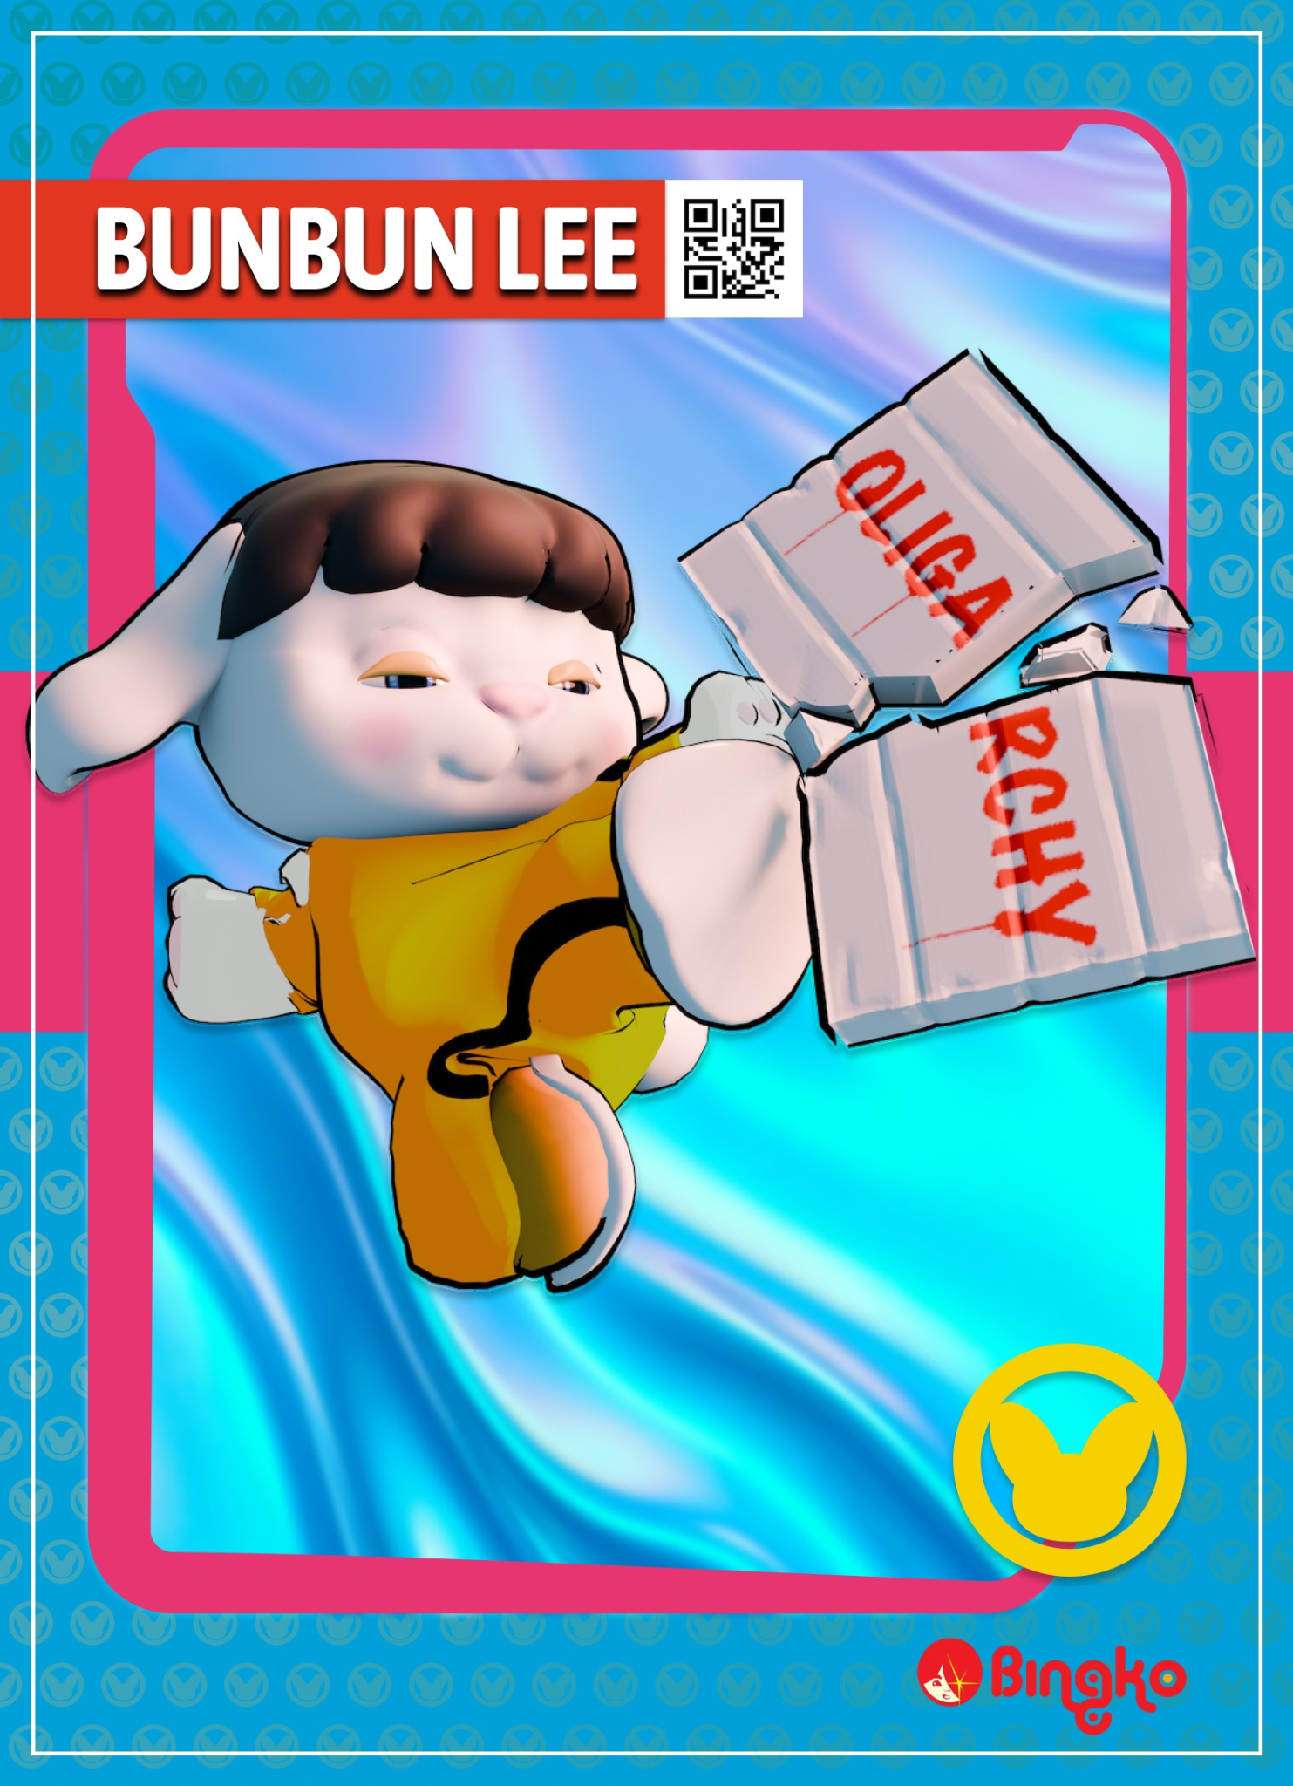
Keith
Elijah, Luiza, Claire, Mikela
Assignment 1
Commercial + Freelance artist → VR/Animation/Filmmaking/Digital
“I canceled my Adobe subscription because they’re not going in a direction I like… It feels like I’m losing creative agency”
Team members role
Some of his artwork!
Luiza — Interviewer/Recorder
Mikela — Note taker
Notes:
We found Chloe working in an art workshop and we also wanted to investigate the perspective of people who do art as a hobby. Additionally, we wanted to hear from someone who was more hands-on with their craft.
Chloe has been doing art for over 20 years and has engaged in various different types of art – such as photography, painting, and printing. She also doesn’t have much experience with digital tools, which is an important aspect to consider when creating a digital solution.

Slide 12
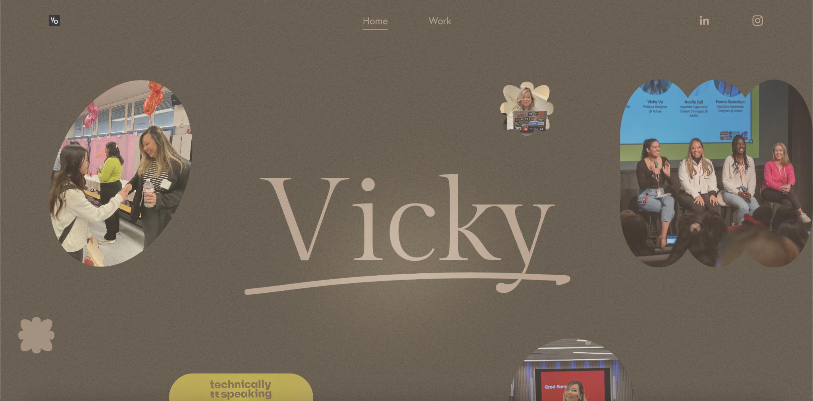
Vanessa
Elijah, Luiza, Claire, Mikela
Assignment 1
Product designer + Art hobbyist → Painting and vector art
“If I’m creating something natural, then I just get ideas from my environment, like a storefront with cool branding”
Some of her art!
Team members role
Elijah — Interviewer/Recorder
Mikela — Note taker
Notes:
We found Chloe working in an art workshop and we also wanted to investigate the perspective of people who do art as a hobby. Additionally, we wanted to hear from someone who was more hands-on with their craft.
Chloe has been doing art for over 20 years and has engaged in various different types of art – such as photography, painting, and printing. She also doesn’t have much experience with digital tools, which is an important aspect to consider when creating a digital solution.

Slide 13
Stephanie
Elijah, Luiza, Claire, Mikela
Assignment 1
Product designer + Art hobbyist → Explores multimedia art and ethics of AI art
“I get the most inspired and motivated when I’m surrounded by other people”
Team members role
Claire — Interviewer/Recorder
Mikela — Note taker
Notes:
We found Chloe working in an art workshop and we also wanted to investigate the perspective of people who do art as a hobby. Additionally, we wanted to hear from someone who was more hands-on with their craft.
Chloe has been doing art for over 20 years and has engaged in various different types of art – such as photography, painting, and printing. She also doesn’t have much experience with digital tools, which is an important aspect to consider when creating a digital solution.

Slide 14
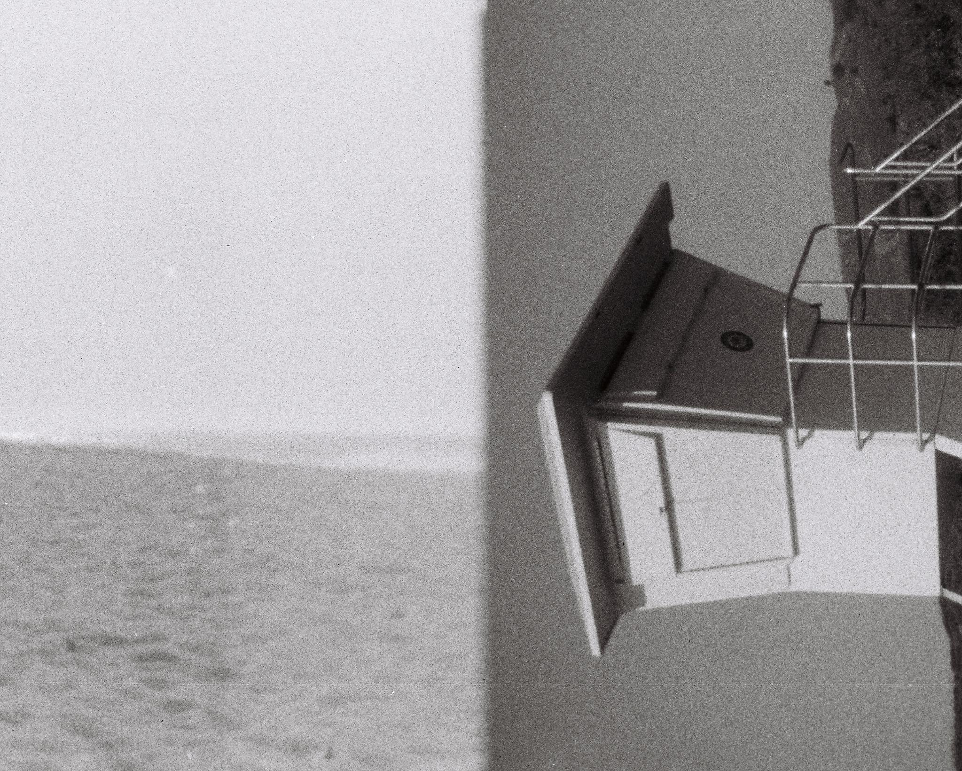
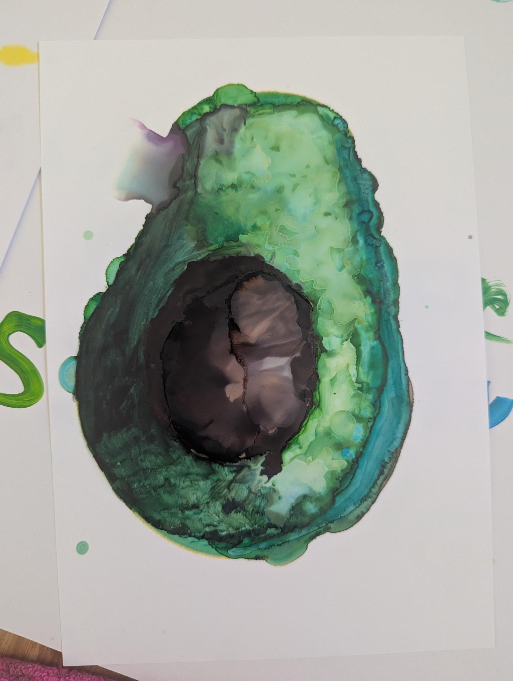
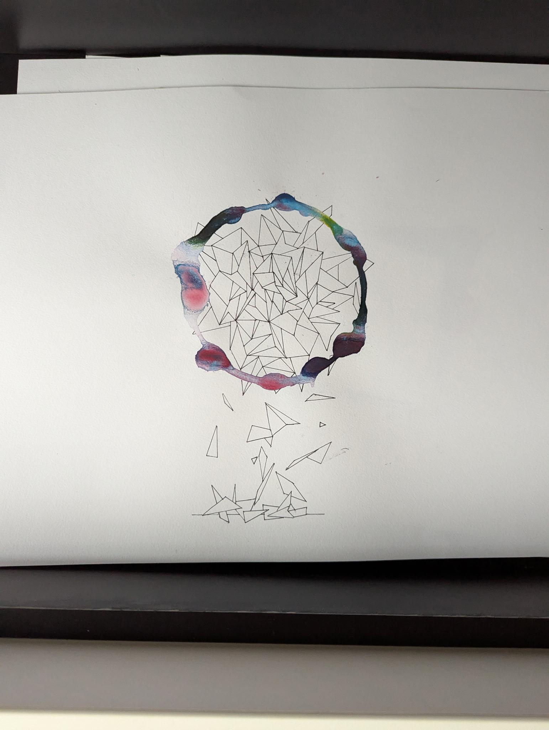
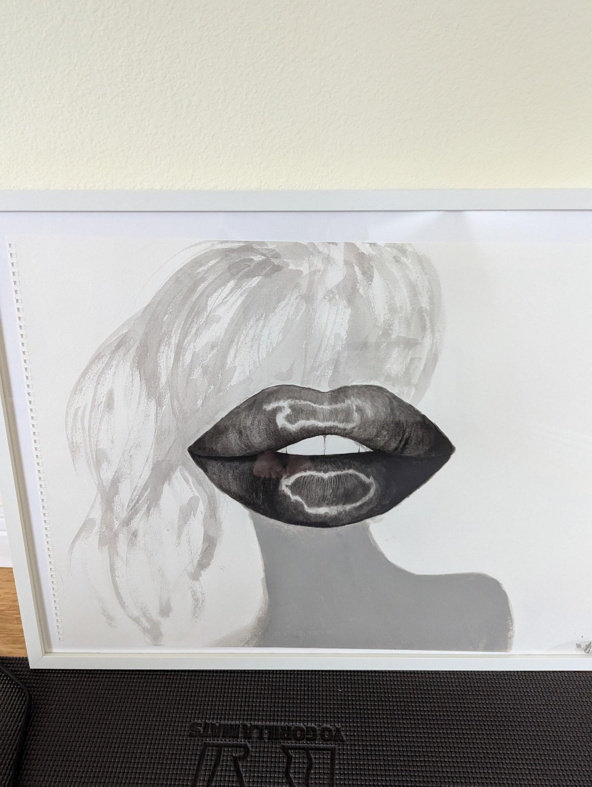
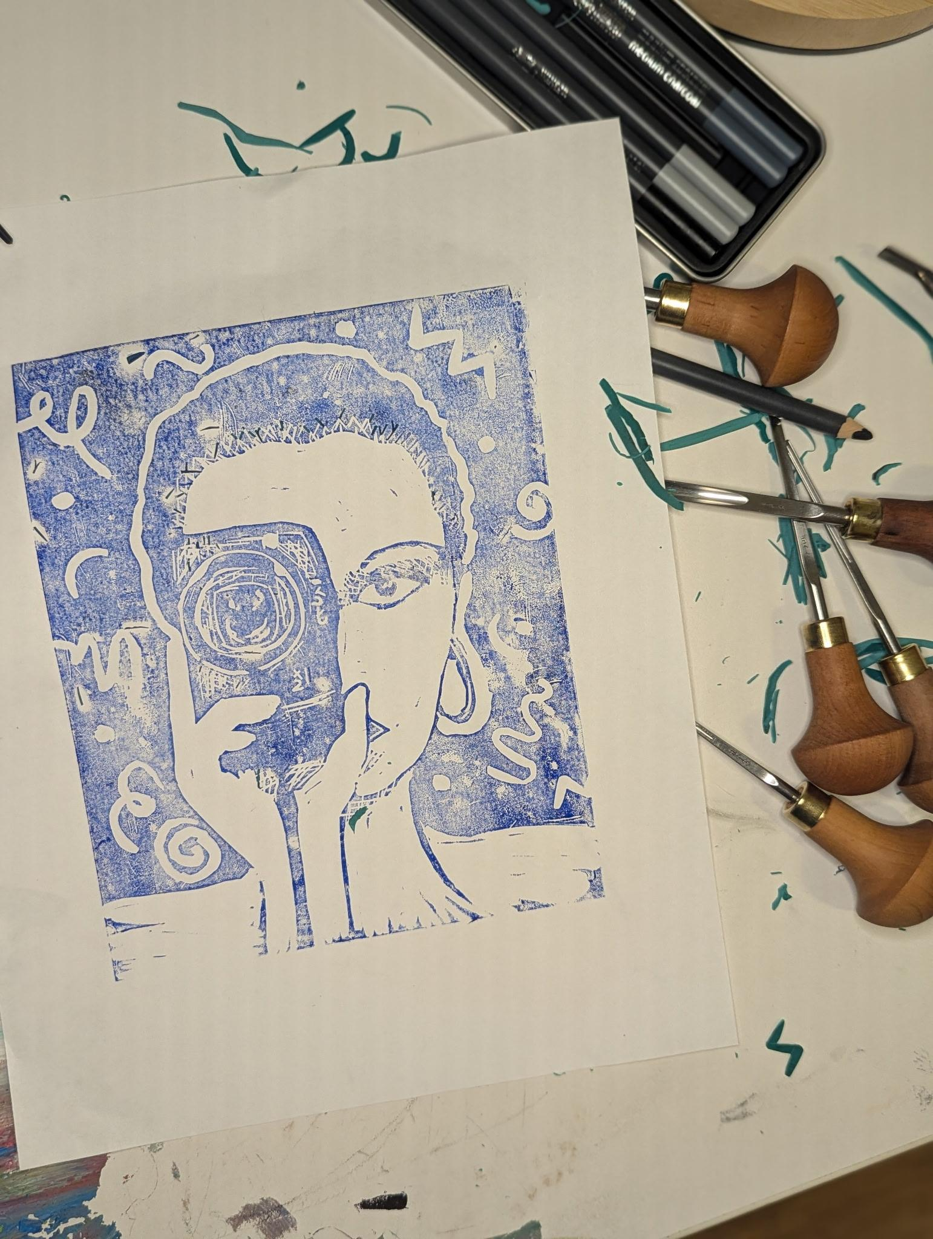
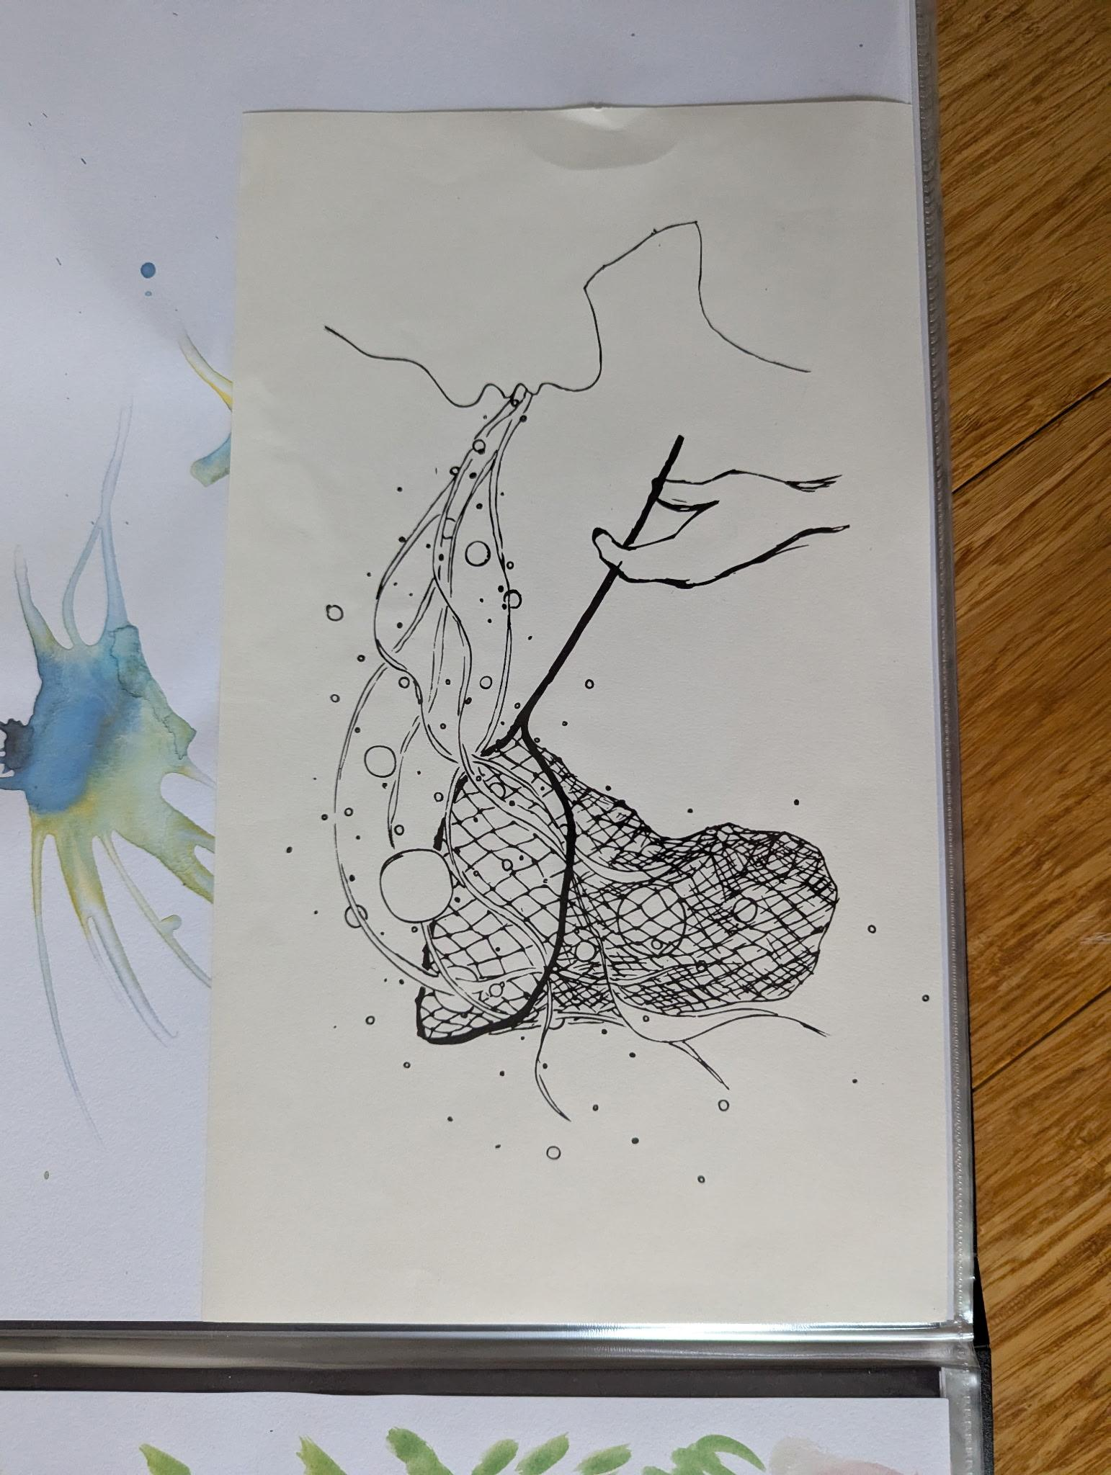
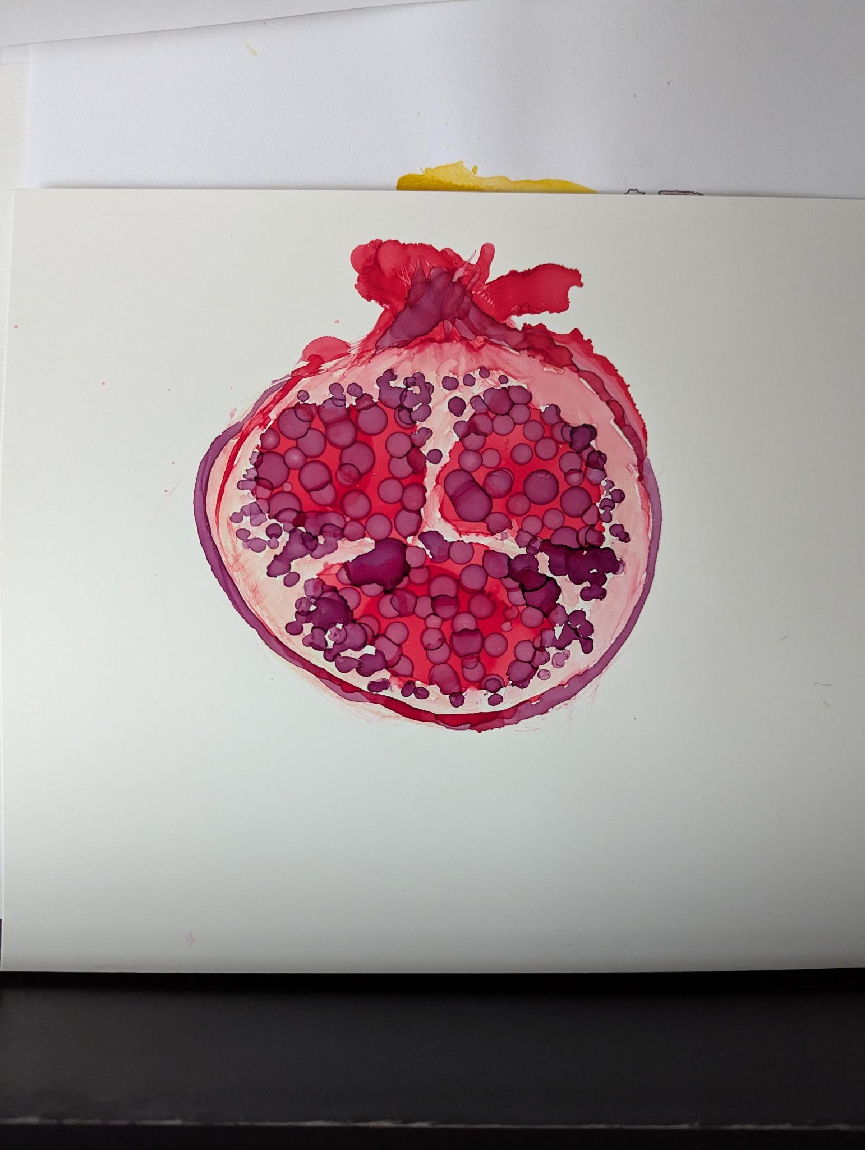
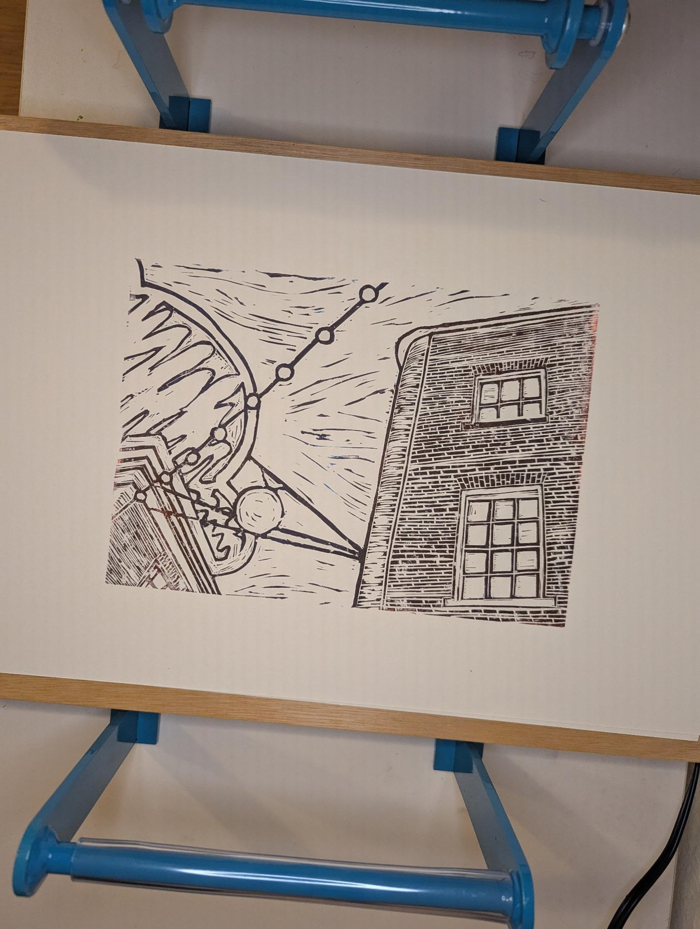
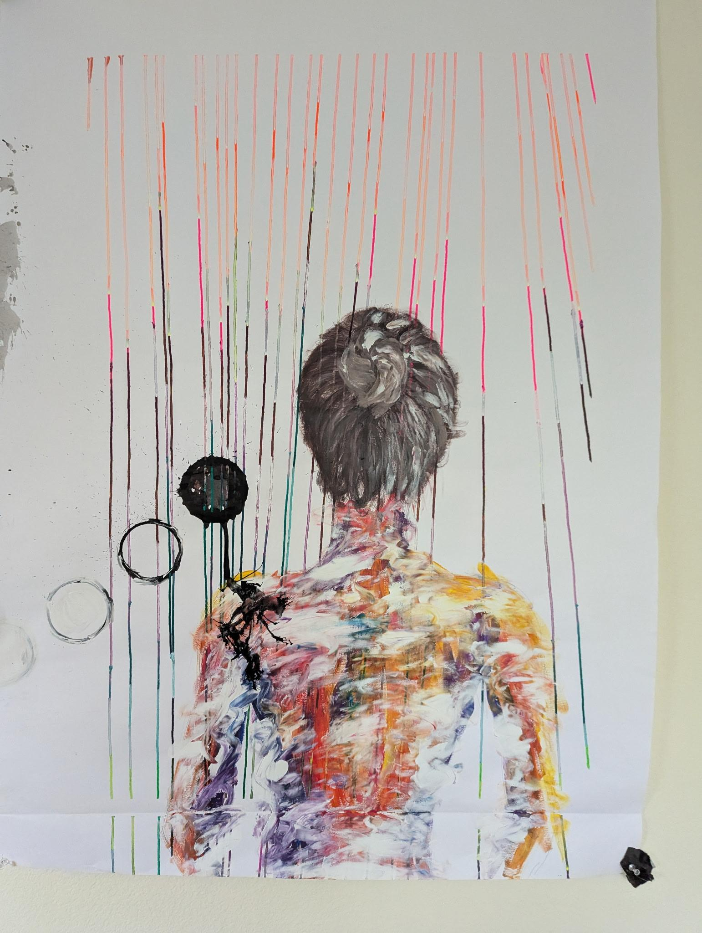
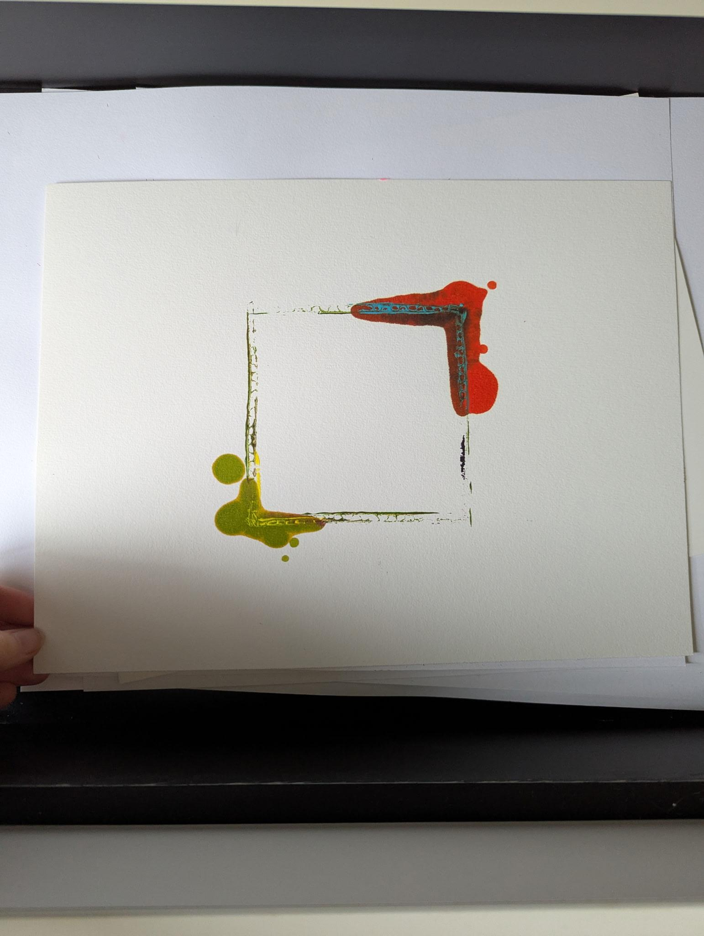
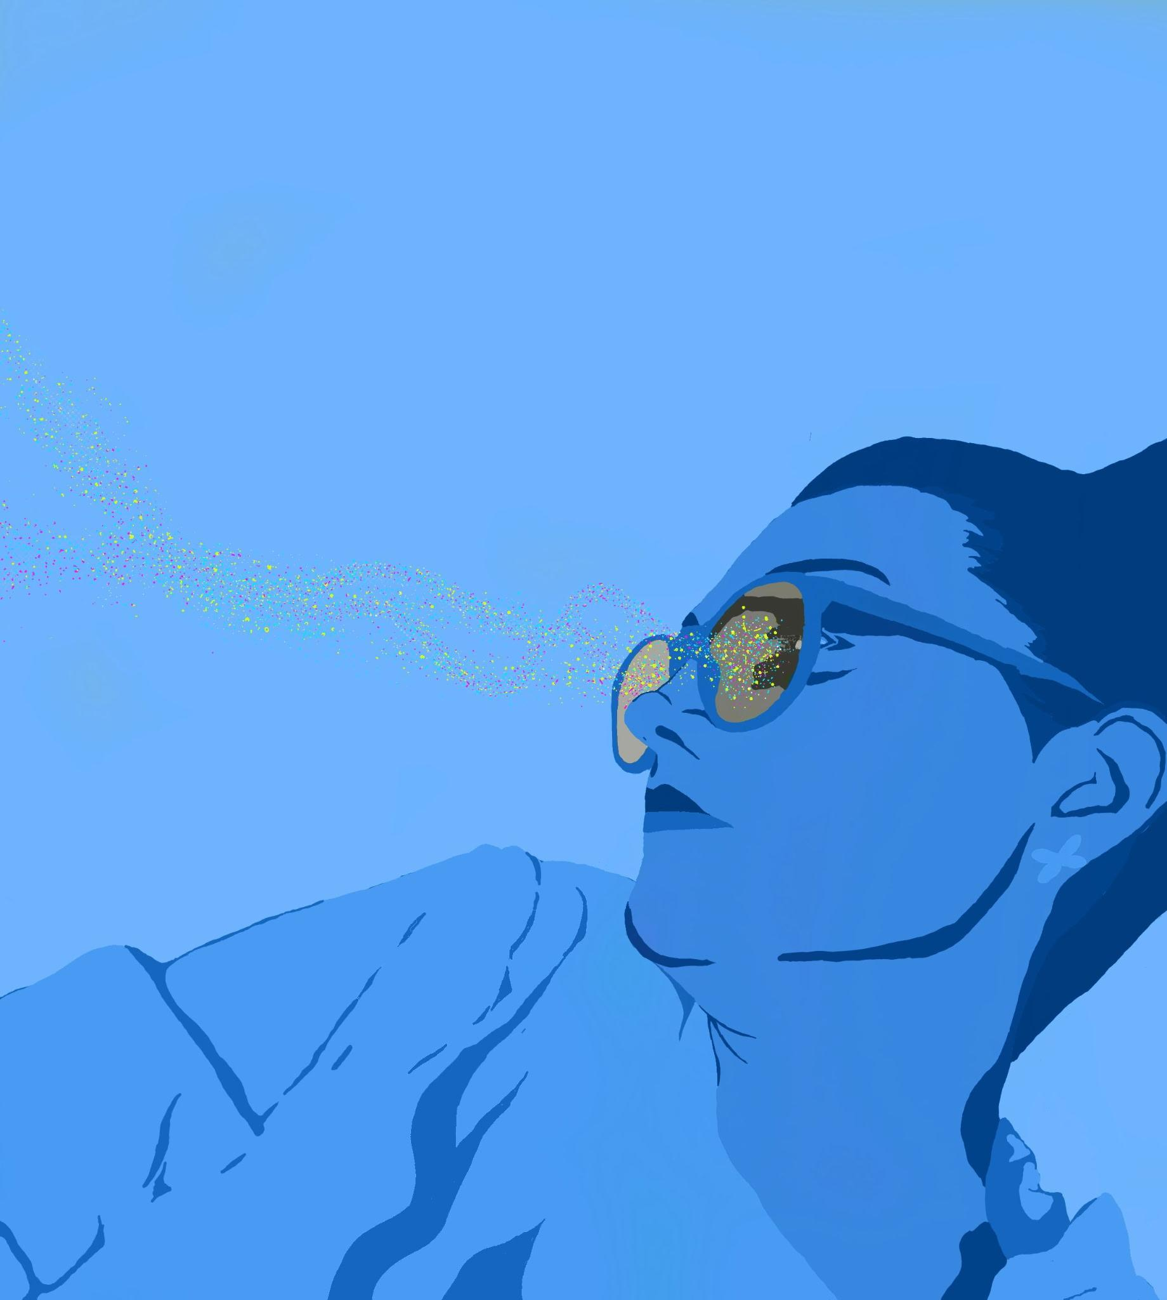
Chloe
Elijah, Luiza, Claire, Mikela
Assignment 1
Longtime art hobbyist → Printmaking, photography, painting
“The best pieces just come out, especially with strong emotions and music.”
Team members role
Some of her artwork!
Luiza — Interviewer/Recorder
Claire — Note taker
Notes:
We found Chloe working in an art workshop and we also wanted to investigate the perspective of people who do art as a hobby. Additionally, we wanted to hear from someone who was more hands-on with their craft.
Chloe has been doing art for over 20 years and has engaged in various different types of art – such as photography, painting, and printing. She also doesn’t have much experience with digital tools, which is an important aspect to consider when creating a digital solution.

Slide 15
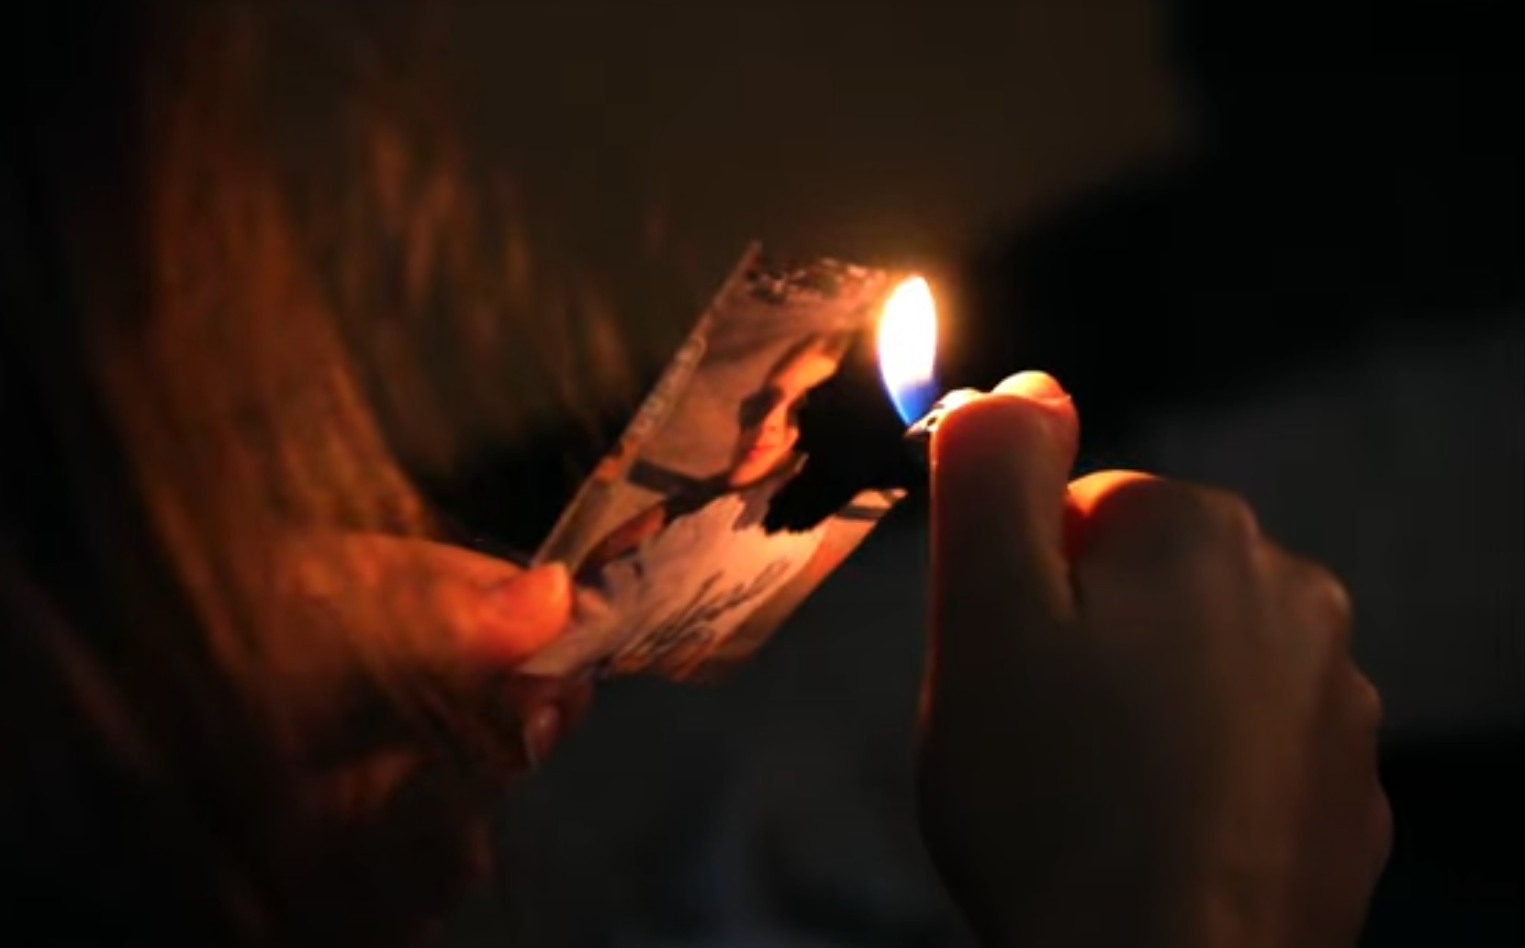
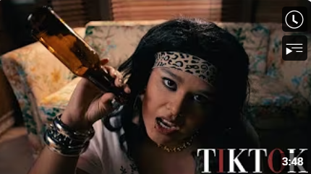
Willow
Elijah, Luiza, Claire, Mikela
Assignment 1
“Art is my safe space.”
“Of course AI can make a simple animation, but there’s no personal feeling to it. There’s no connection to it.”
Film student
(non-user)
Team members role
Claire — Interviewer

Slide 16
Analysis
Elijah, Luiza, Claire, Mikela
Assignment 1

Slide 17
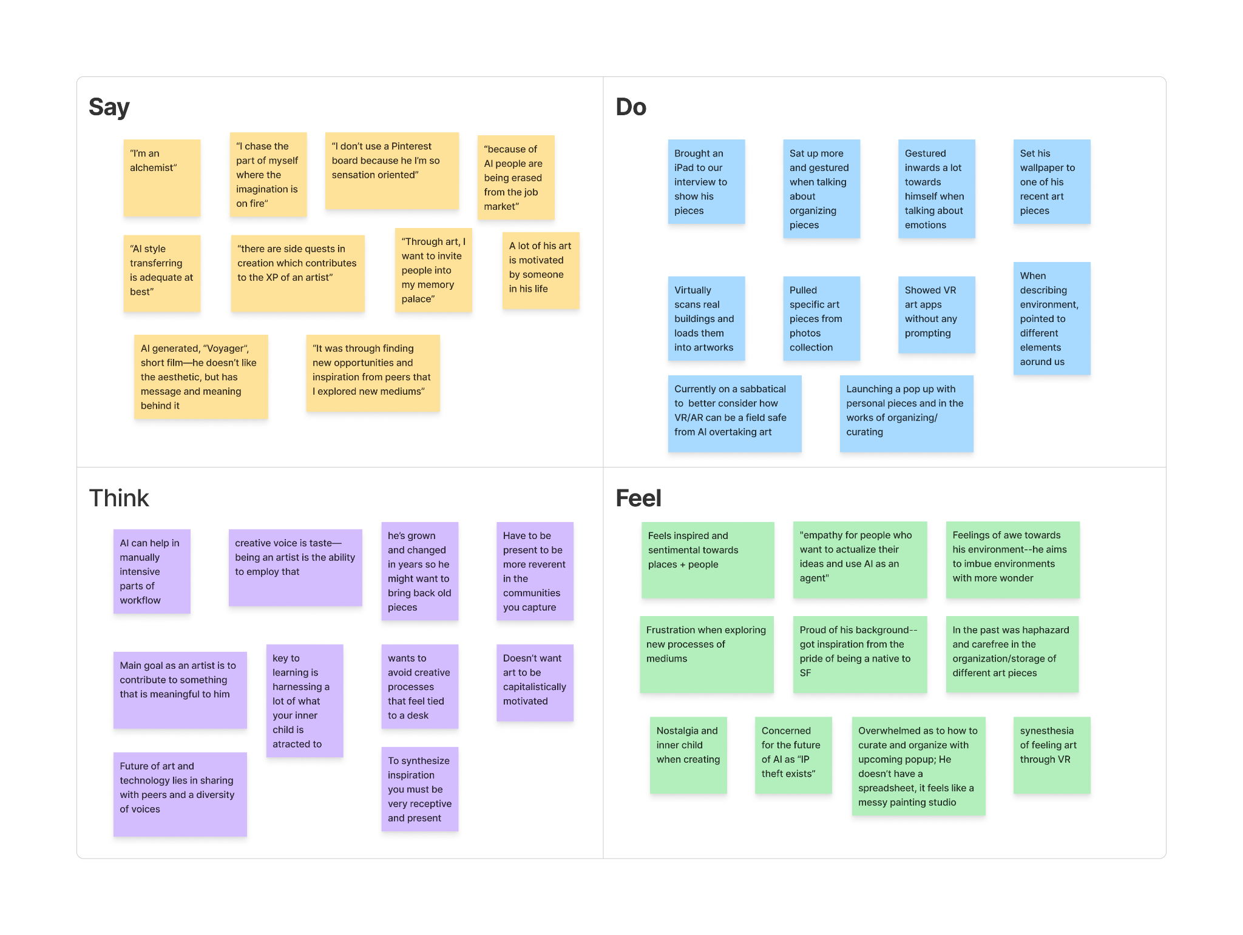
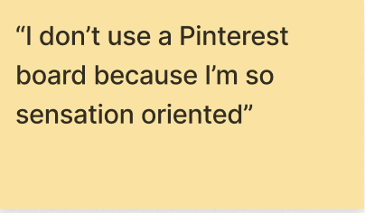
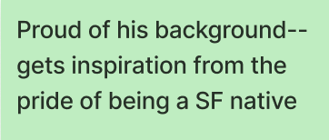
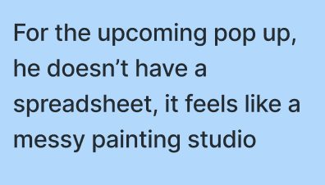
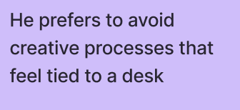
Empathy map 1: Keith
Elijah, Luiza, Claire, Mikela
Assignment 1

Slide 18
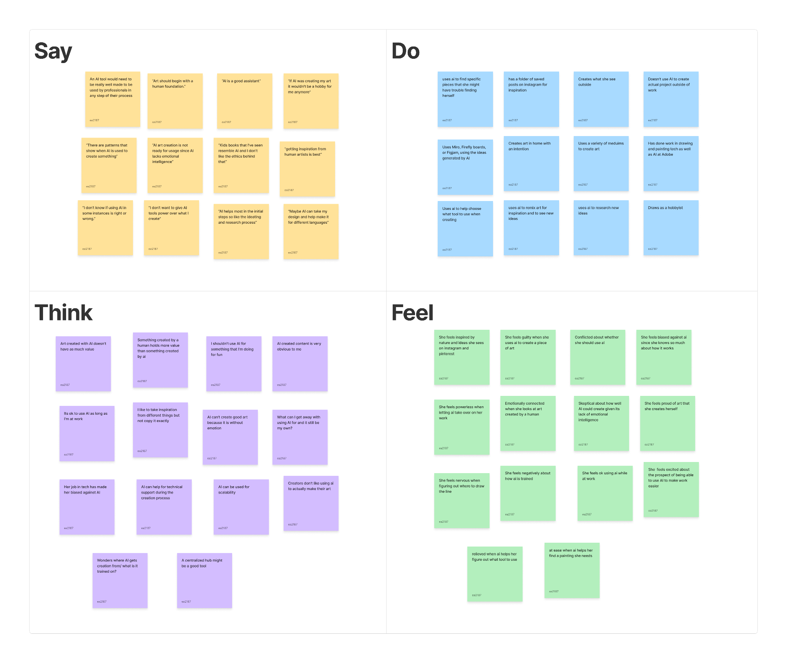
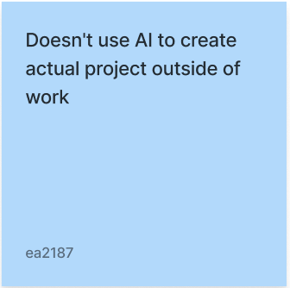
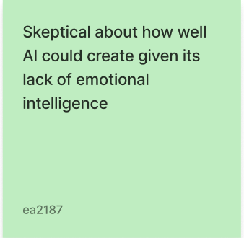
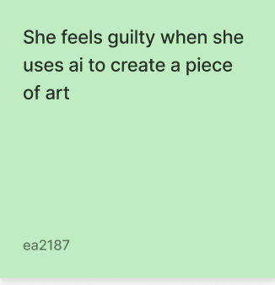
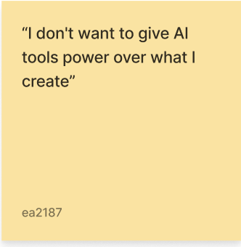
Empathy map 2: Vanessa
Elijah, Luiza, Claire, Mikela
Assignment 1

Slide 19
Contradictions
Elijah, Luiza, Claire, Mikela
Assignment 1
Vanessa:
“Fundamentals of art are inherently human”
Yet, uses ChatGPT to help ideate projects and planning
Stephanie:
“I do not use AI in any art-making processes”
Uses it to generate user cases for product design
Notes:
mikela

Slide 20
Tensions
Elijah, Luiza, Claire, Mikela
Assignment 1
Personal vs. Professional workflow
Personal workflows are more natural and grounded in senses
Professional workflows are highly iterative and tend to incorporate more AI as a means to expedite processes
Recognizing value vs. ethics of Gen AI art
Many realize the potential time savings of AI but say a lot of the “frustration” or “effort” is what delivers value to the art
Notes:
mikela

Slide 21
Surprises
Elijah, Luiza, Claire, Mikela
Assignment 1
Vanessa found it ok to help design AI products for Firefly but feels guilty using it outside of work
All the artists seemed accepting of using AI to help with planning and organization
AI was seen as a way to figure out what tool to use next

Slide 22
Insights and Needs #1
Elijah, Luiza, Claire, Mikela
Assignment 1
Finding
Artists find inspiration for their work in the world around them, working creatively across a variety of mediums.
Insight
Need
Artists prefer to make work that they feel an emotional connection to, which helps them feel more creative. These sources of inspiration can include lived experiences, music, and nature.
Artists need a way to capture and revisit these spur of the moment sources of inspiration to support their creative processes.
Notes:
claire

Slide 23
Insights and Needs #2
Elijah, Luiza, Claire, Mikela
Assignment 1
Finding
Artists store their ideas and work across multiple systems, which can be difficult to keep track of.
Insight
Need
Artists who don’t have a reliable way to store their ideas and past projects struggle to remember needed details, even if they are documented.
Artists need to easily and intuitively organize their work and ideas all in one place, that allows them to quickly come back to.
Notes:
claire

Slide 24
Insights and Needs #3
Elijah, Luiza, Claire, Mikela
Assignment 1
Finding
Artists believe that the foundation of art should be human. It is for them to connect and build relationships with other people.
Insight
Need
There is a very human aspect to making art. Humans can be a source of inspiration, with art often being a means of connecting with others and even conveying the human experience.
Artists need to feel connected with human experiences and relationships — both to find inspiration and create work that resonates with others.
Notes:
claire

Slide 25
Summary
Elijah, Luiza, Claire, Mikela
Assignment 1
We talked to 5 people about their process in making art and how they engage with different tools and mediums
We found that most artists find inspiration from a variety of different sources — music, movies, locations, people, and feelings.
Most artists don’t have a very organized way of saving and storing their pieces or sources of inspiration
A lot of them believe that art should be fundamentally human and if AI were to play a role in it, it should be for more automatic and mundane steps

Slide 26
What’s Next
Elijah, Luiza, Claire, Mikela
Assignment 1
Gain a better understanding of specific use cases with existing tools (crucial to understand HMW)
Explore the idea of community and how it manifests online and in planning
Pinterest
Online art challenges
Interview more beginner artists with less established workflows
Notes:
Luiza

Slide 27
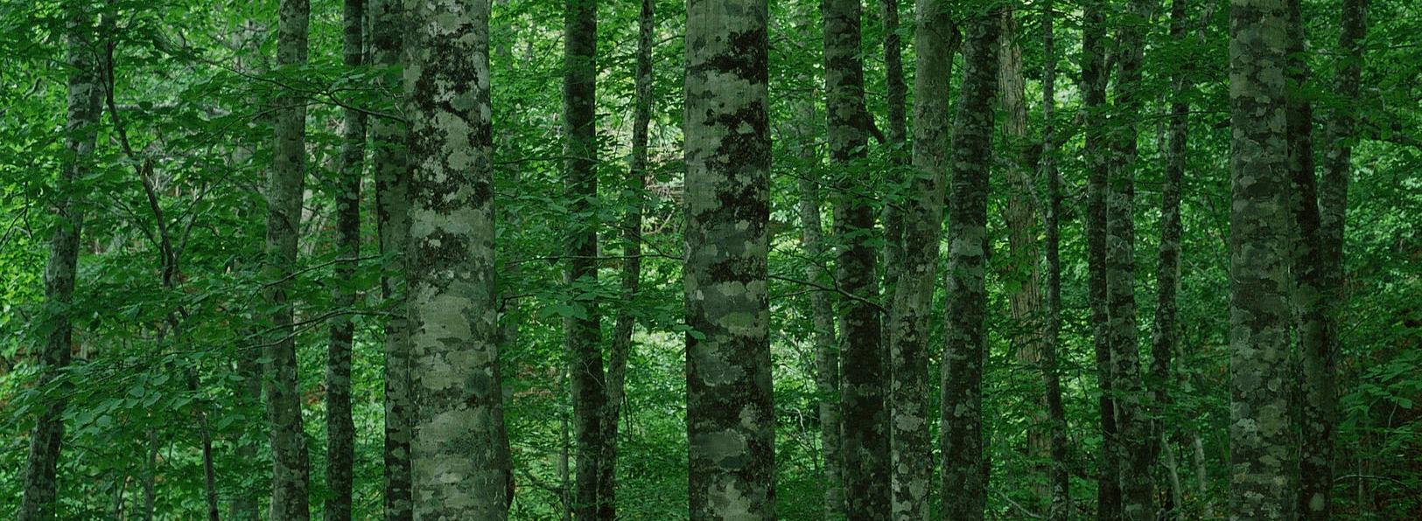
Thank you!
Luiza, Claire, Mikela, Elijah
Assignment 1

Slide 28
Appendix
Elijah, Luiza, Claire, Mikela
Assignment 1

Slide 29
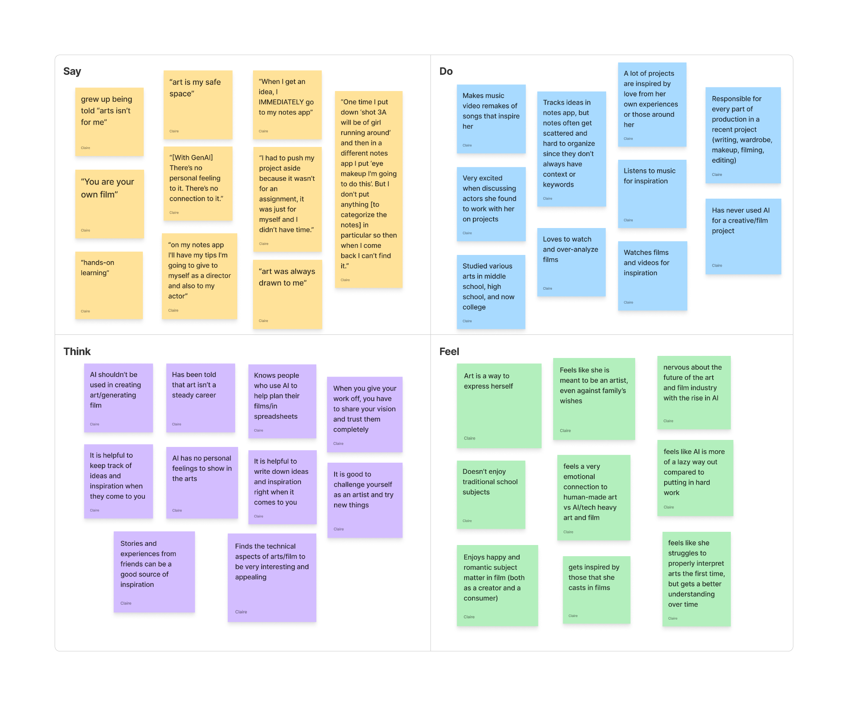
Willow Empathy Map
Elijah, Luiza, Claire, Mikela
Assignment 1

Slide 30
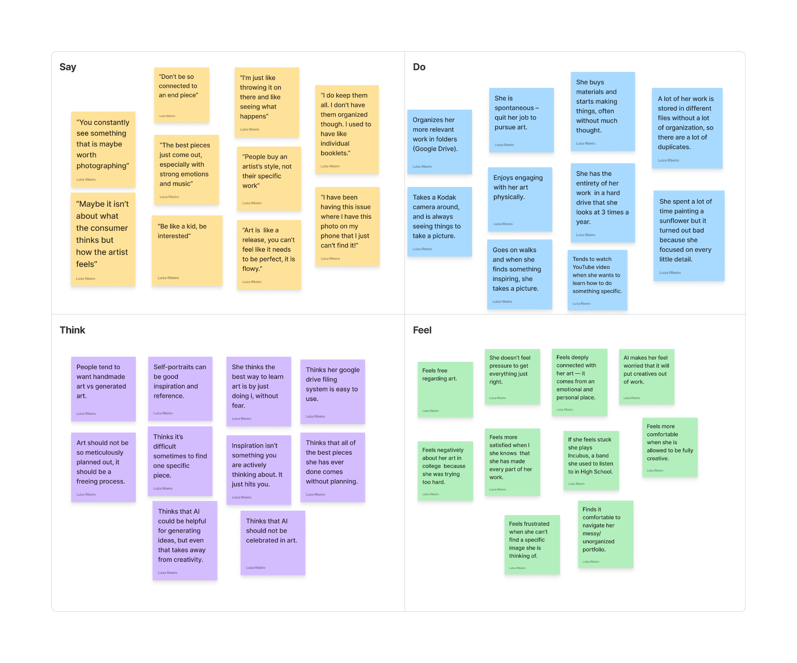
Chloe Empathy Map
Elijah, Luiza, Claire, Mikela
Assignment 1

